Slide 1
Finnish Media Landscape:
The State and the Future of Newspapers
Estonian Newspaper Association 5.12.2012 Jukka Holmberg

Slide 2
Finnish Newspapers Association
142 member companies: mostly newspaper publishers and city newspaper publishers
  181 newspapers (about 140 local newspapers)
  57 city newspapers (free)
  Other company members
  marketing companies
  news agencies
  distribution companies
  printing works

Slide 3
The Mission
The main focus of Finnish Newspapers Association is to strengthen newspapers’
  influence in the Finnish society
  vitality
  the role as a leading media for readers and advertisers
  the position in people´s lives
in all platforms!

Slide 4
Strategic areas
Image strengthening
Newspaper business is a growth business
New readers and users

Slide 5
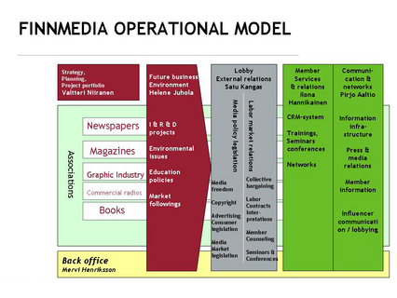
The Federation of the Finnish Media

Slide 6
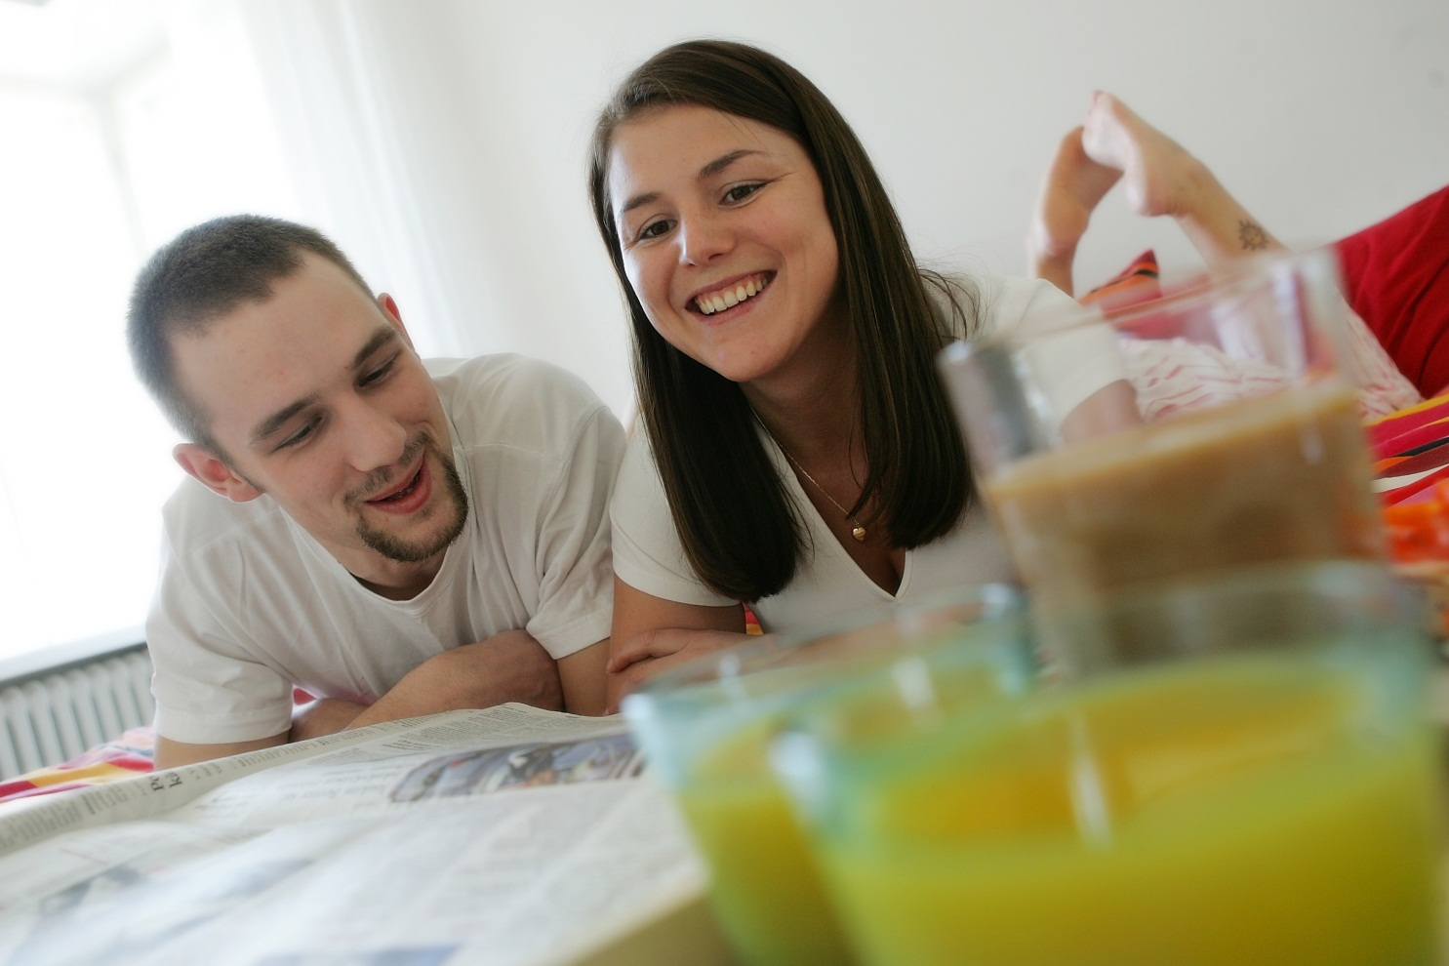
Finns love and trust their newspapers

Slide 7
Challenges for newspapers in Finland
1. Tight competition of peoples time and money
2. Digitalisation (how to get incomes)
3. New VAT for subscriptions (from 0 to 9 %)
4. Financial crisis in Europe

Slide 8
Time spent daily on different media
(Total 8 h 33 min)
30 concentrated minutes for printed newspapers every day!
Source: TNS Atlas Intermedia 2011, TNS Gallup

Slide 9
Also youngsters still read printed newspapers (reach-%)
Source: National Readership Survey 2011, KMT Lukija 2011

Slide 10
Reach of dailies in Nordic countries
%
Source: World Press Trends 2010, World Association of Newspapers

Slide 11
Reads newspapers or magazines at least once a week (%)
Printed PC Mobile phone Tablet

Slide 12
Newspaper reading in various channels
Percentage of Finns
Source: KMT Lukija (National Readership Survey. Spring 2012)

Slide 13
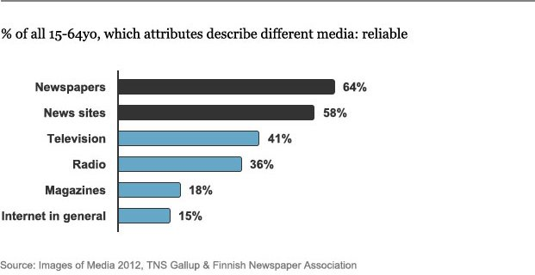
Media Perception

Slide 14
Newspaper attributes
Strengths of newspapers compared to average value of all media
All respondants, % | Newspapers | Average, all media | Difference, percentage points
Local | 63 | 22 | 41
Valued | 81 | 42 | 39
Credible | 70 | 37 | 33
Secure | 64 | 31 | 33
Expert | 74 | 45 | 29
Trustworthy | 64 | 35 | 29
Responsibe | 60 | 31 | 29
Socially responsible | 56 | 29 | 27
Good quality | 63 | 38 | 25
Helps choose products and places of purchase | 51 | 26 | 25
Helps in everyday matters | 55 | 35 | 20
Supports welfare of Finns/citizens | 49 | 32 | 17
Supports responsible parenthood | 39 | 24 | 15
On the side of ordinary people | 42 | 28 | 15
Helps to understand reasons behind issues | 64 | 49 | 15
Source: Medioiden mielikuvat 2012, Finnish Newspapers Association & TNS Gallup Oy

Slide 15
People working in newspapers (managing directors, chief editors, editors, marketing directors) value newspaper really high
All respondants, % | Newspapers | Average, all media | Difference, percentage points
Local | 63 | 22 | 41
Valued | 81 | 42 | 39
Credible | 70 | 37 | 33
Secure | 64 | 31 | 33
Expert | 74 | 45 | 29
Trustworthy | 64 | 35 | 29
Responsibe | 60 | 31 | 29
Socially responsible | 56 | 29 | 27
Good quality | 63 | 38 | 25
Helps choose products and places of purchase | 51 | 26 | 25
Helps in everyday matters | 55 | 35 | 20
Supports welfare of Finns/citizens | 49 | 32 | 17
Supports responsible parenhood | 39 | 24 | 15
Sides with ordinary people | 42 | 28 | 15
Helps to understand reasons behind issues | 64 | 49 | 15
Difference
30
%-age points
Source: Medioiden mielikuvat 2012, Finnish Newspapers Association & TNS Gallup Oy

Slide 16
Young people give very good ratings
Evaluation of newspapers and experiences of the benefits
Print readers:
Web readers:
Young readers:
Do rate his/her newspaper as excellent or at least good
82 %
81 %
88 %
Obviously going to read his/her own newspaper also in the future
94 %
93 %
93 %
Talking positively about his/her own newspaper
88 %
82 %
88 %
Is getting more benefit by reading own newspaper than using other media content
85 %
79 %
81 %

Slide 17
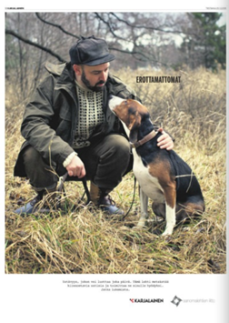


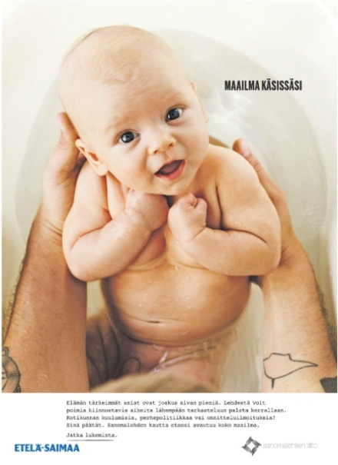
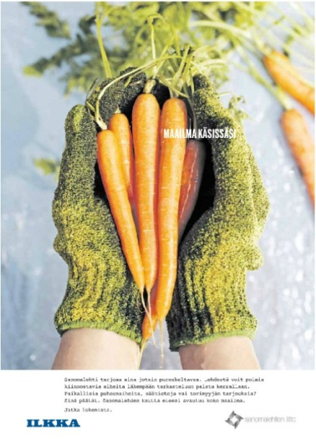
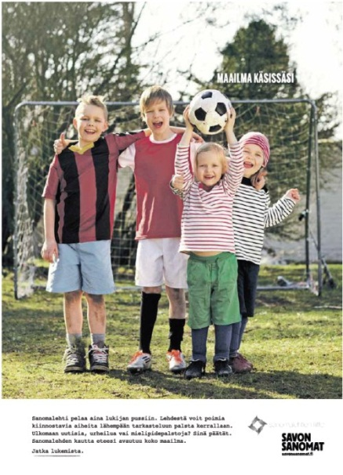
Near, dear, close, local, beneficial...

Slide 18
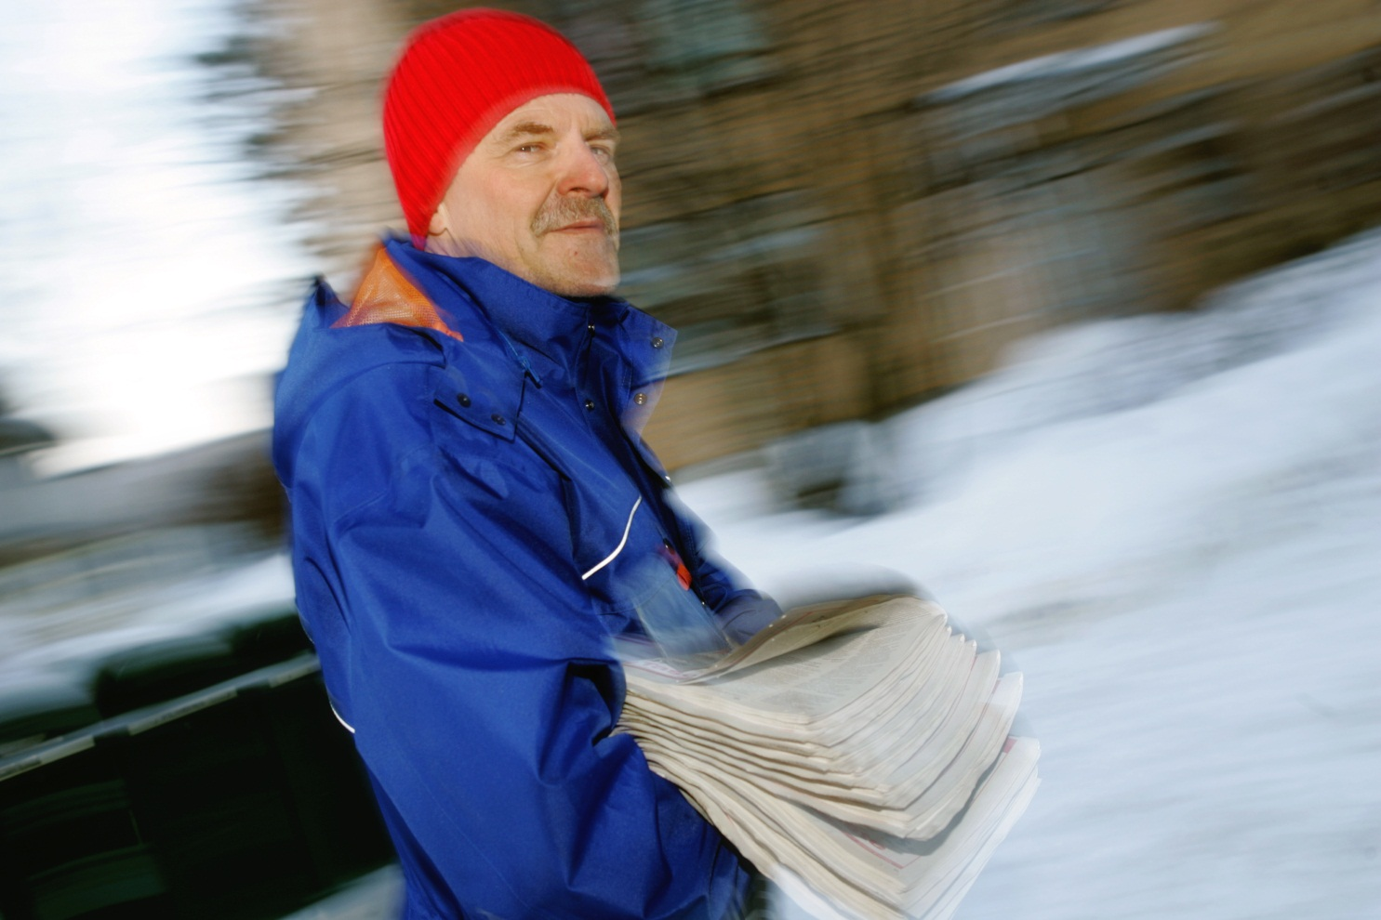
Circulations still on a high level

Slide 19
Top ten newspapers in Finland
Circulation 2011
Source: Finnish Audit Bureau of Circulations

Slide 20
Total newspaper circulation 2002–2011
Source: Finnish Audit Bureau of Circulations
Notes:
Levikit 2002-2010 otettu vuonna 2011 Levikintarkastuksen tietokannasta, vuoden 2011 levikki v. 2012.

Slide 21
Newspaper countries 2009
Newspaper circulation/1 000 inhabitants
Source: World Press Trends 2010, World Association of Newspapers
Countries with assesment based circulation have been left out.

Slide 22
Online newspaper visitors
Unique visitors / week
Source: TNS Metrix

Slide 23
Total reach bigger than ever print + online 2011, reach-%
Source: National Readership Survey 2011 (Reader + Consumer)
Net reach: reader counted either as print or online reader ie just once.
Notes:
Yhteistavoittavuusluku on lehden keskimääräisen numeron lukijamäärä lisättynä verkkolehden keskimääräisellä viikkokävijämäärällä (nk. nettotavoittavuus eli henkilö voi olla luvuissa mukana vain kerran). KMT:ssä mukana 40 sanomalehteä.

Slide 24

Newspaper business

Slide 25
Mass media market 2011
Total 4.3 billion euros (2,2 % of GNP)
Source: Mass media and cultural statistics, Statistics Finland

Slide 26
Newspapers’ income structure
Total 1,1 billion euros in 2011
Sources: Suomen Lehdistö 6– 7/2012 & Finnish Newspapers Association

Slide 27
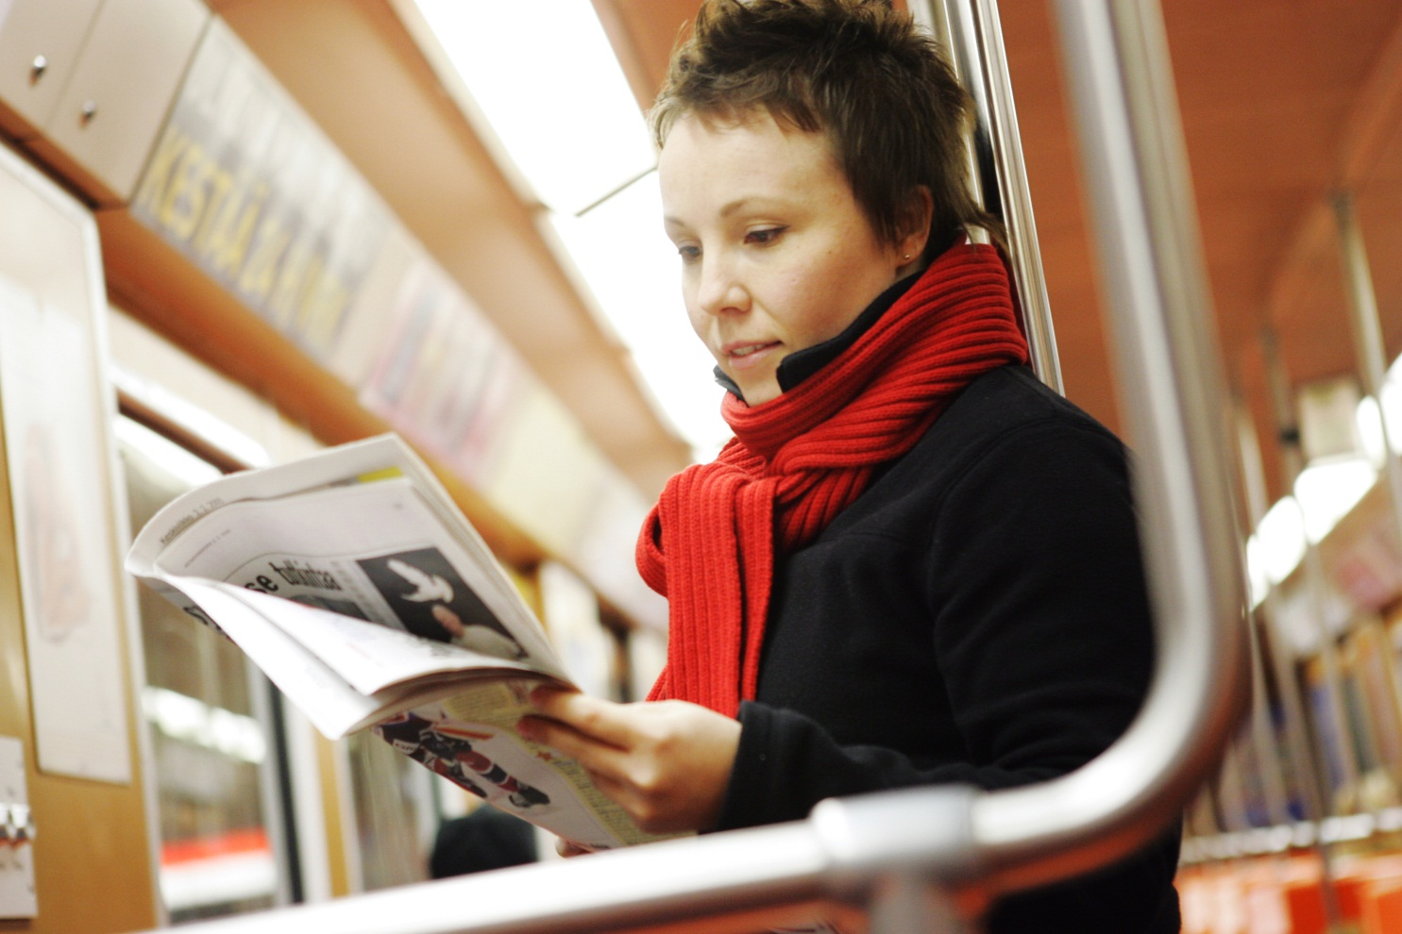
The biggest advertising channel

Slide 28
Media advertising shares
Total 1,4 billion euros in 2011
Source: Finnish Advertising Council & TNS Gallup Oy, Media Intelligence

Slide 29
Structure of newspaper advertising
Share of media euros in 2011
Source: Amount of media advertising january 2011 – december 2011, TNS Gallup Oy, Media Intelligence

Slide 32
Hot topics in Finland just now: tabloids, tablets and paywalls

Slide 33
Newspaper formats in Finland
Tabloid Broadsheet
1-3 x/week 129 4
4-6 x/week 14 3
7 days a week 8 23
Total 151 30
City newspapers 42 16

Slide 34
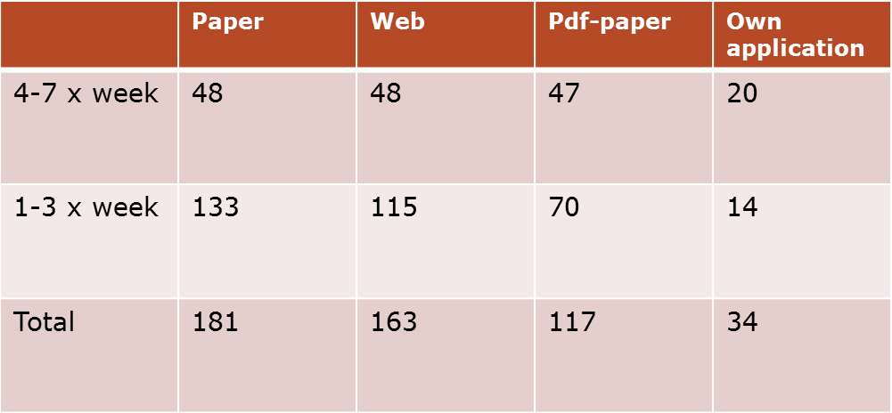
Newspapers platforms in Finland
June 2012

Slide 35


Combo subscriptions, paywalls, subscription & tablet bundles, new products and services, higher revenue ads to tablets...

Slide 36
Sotf paywalls are coming: papers need to get income from digital world too
Kauppalehti started the boom in May 2012
  Only 25 articles for free in a month
Helsingin Sanomat put up their paywall in November 2012
  Only 5 articles for free in a week
  Digital subscription or bundle subscription with printed paper or subscription with an iPad
Many papers will follow soon
Some will have only one subscription which give access to papers’ all content in all platforms

Slide 37
What next?

Slide 38
Newspaper of the future?

Slide 39

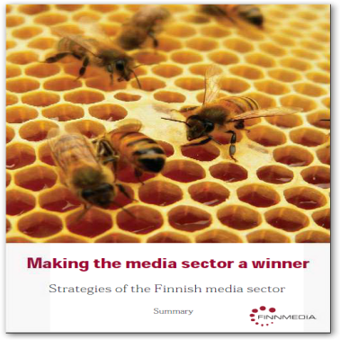

Based on
the media
industry
strategy
“Making the media sector a winner”
Next Media aims at innovations in media experience, new business models, concepts and technology.
Precompetitive co-operation
Breakthrough target:
Next Media aims at renewing the business environment of the media sector by breaking the limits of media content and changing the way media is created, configured, serviced and consumed.
Planned for 2010-2013
57 companies
9 research organisations
100 person years
10 M€
Coordinator
Notes:
1st step in the spring 2009: joint strategy for the Finnish media sector by the Federation of the Finnish Media Industry, Finnmedia
Strategy process as important as the strategy itself - commitment
The preparation of the Next Media SRA (Strategic Research Agenda) and SHOK programme initiated simultaneously
Toimialastrategian merkitys mediakentän yhtenäiseen esiintymiseen Next Mediassa esikilpailullisella tasolla?
Näin laajaa mediatutkimusta ei ole aiemmin tehty

Slide 40
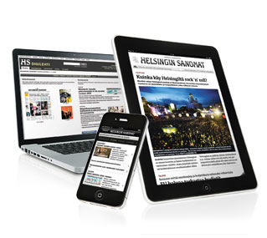
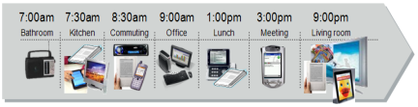
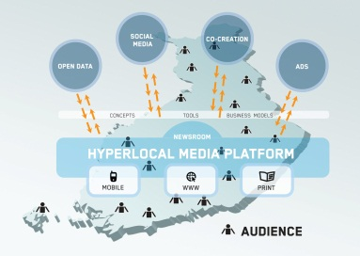
Next Media: Three main areas
eReading
Editorial content and adverts in new platforms
    Personal Media Day
  Consumer and user research
  New services and business models
Hyperlocal
User generated content
Open data journalism
Automatic editorial processes

Slide 41
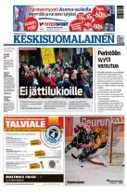
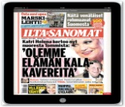


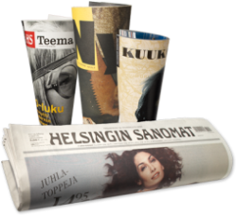



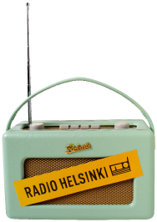
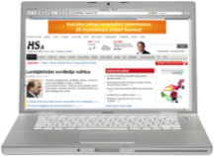

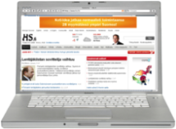
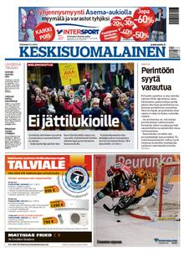
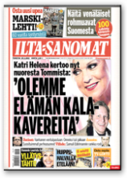
Personal Media Day
Whenever
Morning
Wherever
Evening
However
On the way to work
Interactivity
On the way to home
Social media
Work
My own content
Work
Lunch
Connection
Place
6.12.2012
41
NEXT MEDIA - A TIVIT PROGRAMME
41
Notes:
From time-bound
(morning) to whenever
From place-bound (home delivery) to wherever
From platform-bound (print) to whatever digital device
From broadcast to interactive
Kuluttajan aika on keskeinen kilpailukohde: digitaalisessa arjessa kuluttajan huomiosta kilpailee moni muukin palvelu. Next Median tavoite on laajentaa kuluttajan sitoutumista mediabrändeihin perinteisten aika- ja paikkarajoitteiden yli koko päivän kestäväksi ja siten kasvattaa median osuutta kuluttajan arjen ajankäytössä (Personal Media Day) .

Slide 42
Thank you!
Jukka Holmberg
Executive Director
Finnish Newspapers Association jukka.holmberg@sanomalehdet.fi www.sanomalehdet.fi

